Slide 1
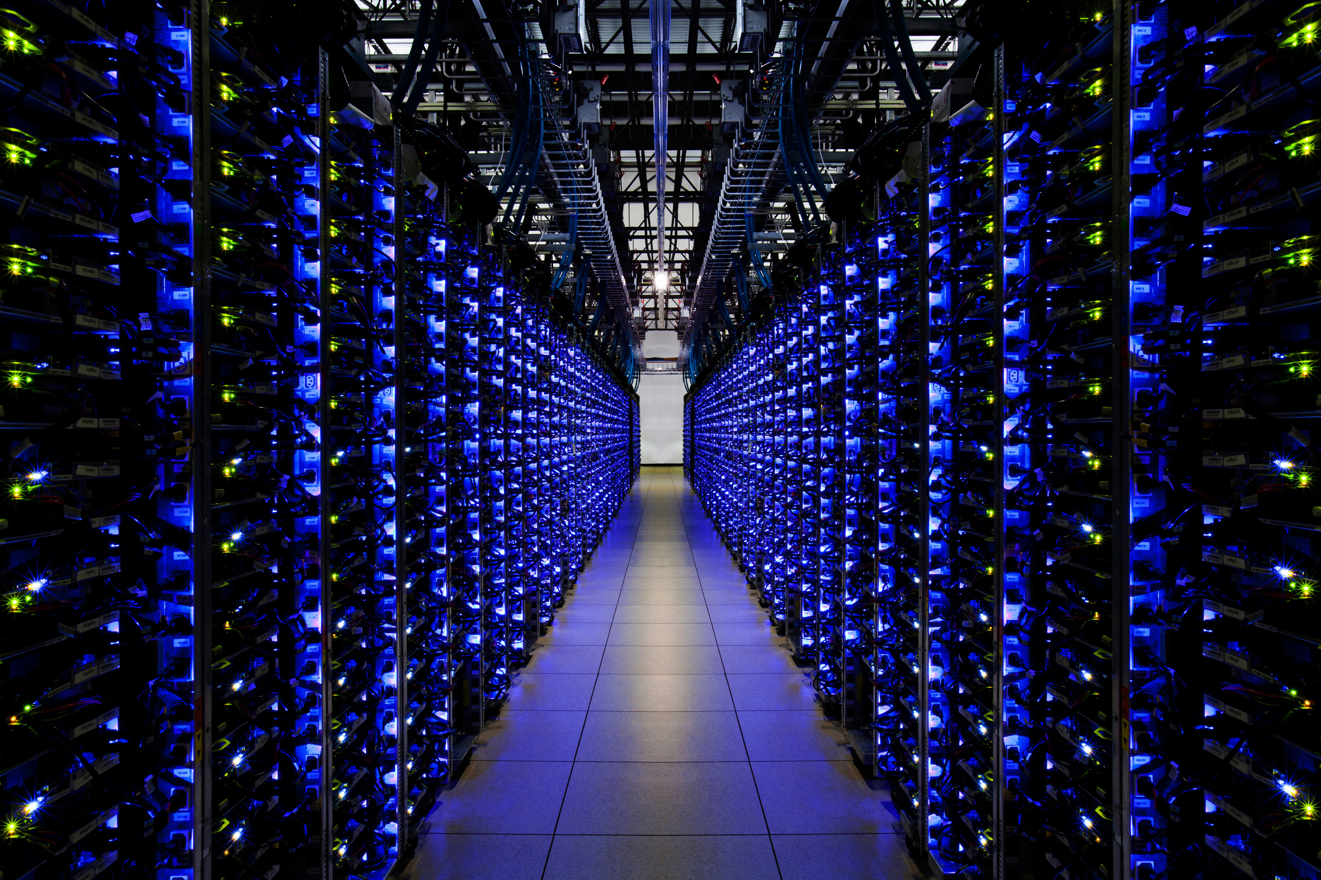
Let's Build a Server

Slide 2
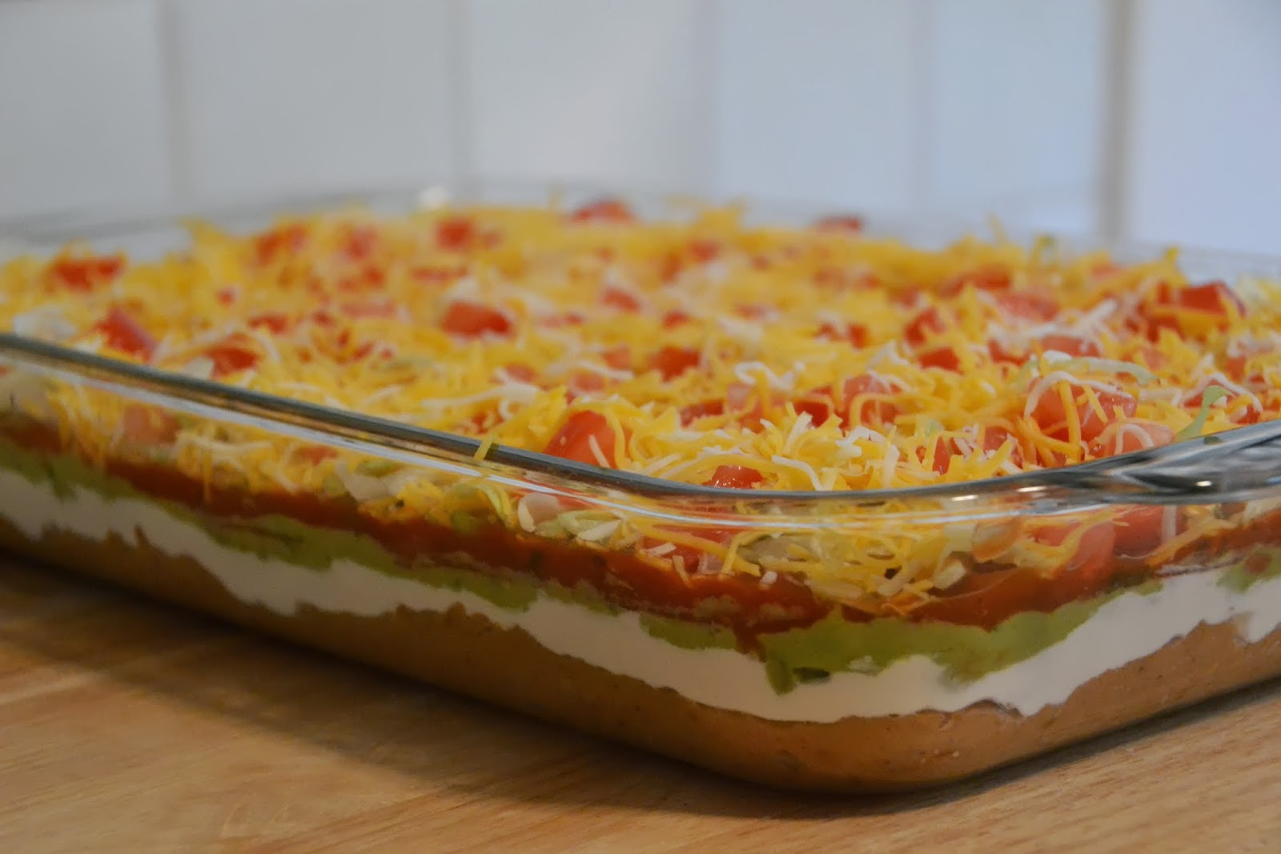
Notes:
What is this? (7-layer dip)
Computers have many layers. You can make an entire (good) career only understanding a single layer. Or you may know multiple layers at the surface level.
Here at our Dojo we're going to dive into multiple layers so that you get exposed to as much as possible and can determine what you want to learn more about!

Slide 3
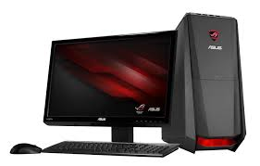
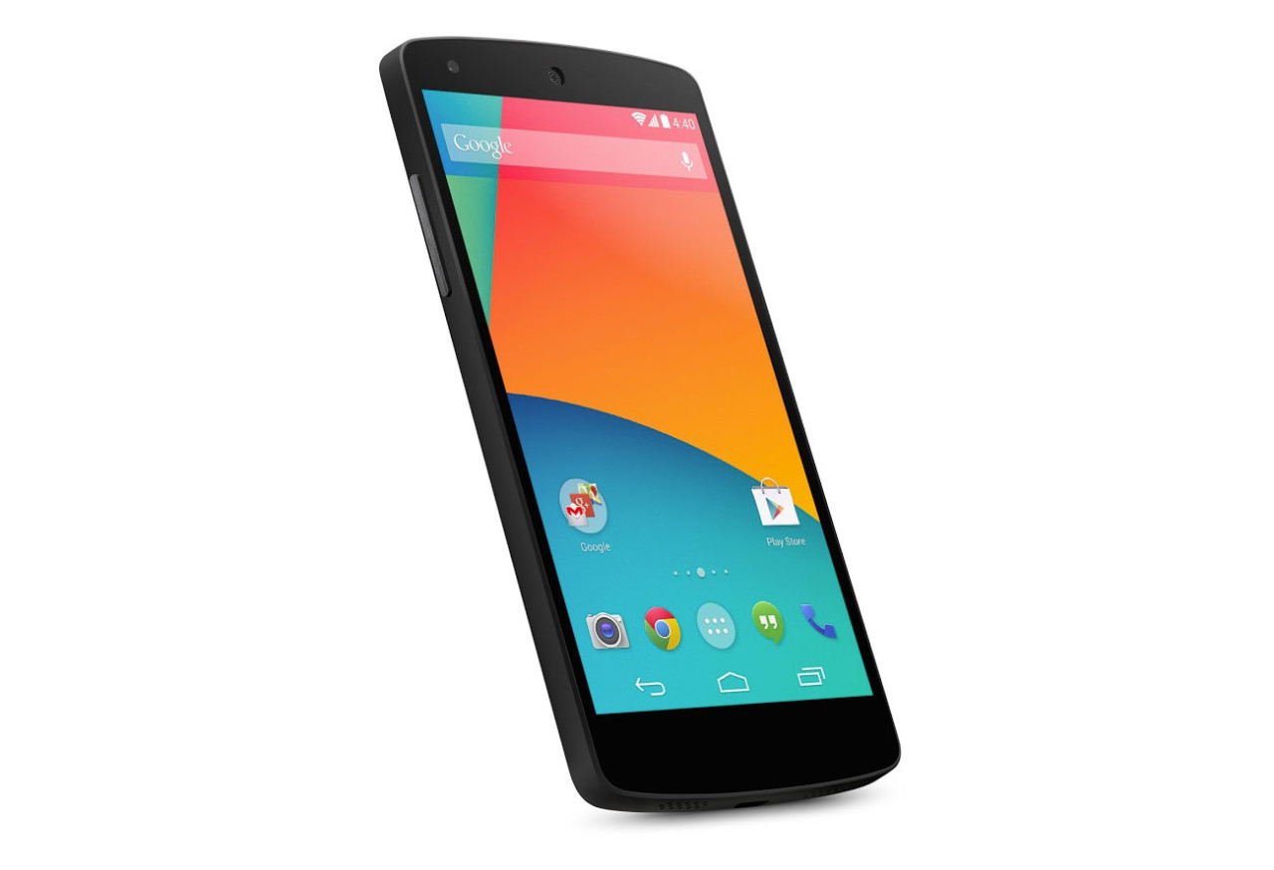

What is a Server?
Notes:
A server it a type of computer which handles communication between clients and itself.
Usually you would run some kind of program on the server that multiple clients could connect to
At it's core, a server is just a computer. Anything that is a computer can be a server!

Slide 4
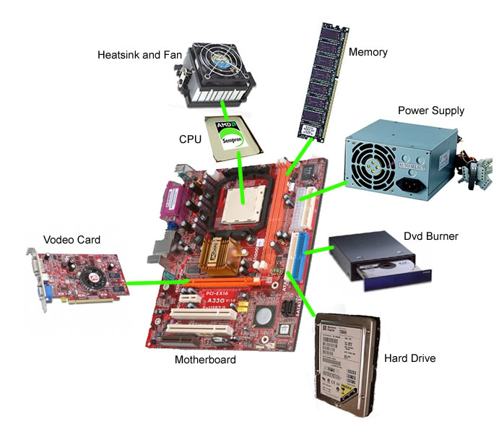
Parts of a Computer
Notes:
Video card... lol
These are the basic part of a computer. Our parts may look different, just like they look different in your phone or thermostat, but theses functionalities exist.

Slide 5
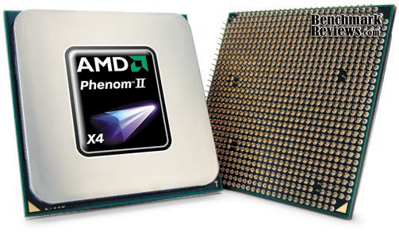
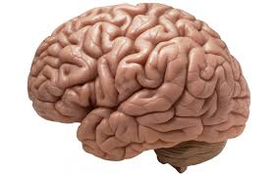
CPU
Notes:
The CPU (central processing unit) is the brains. It does most of the thinking for the computer.

Slide 6
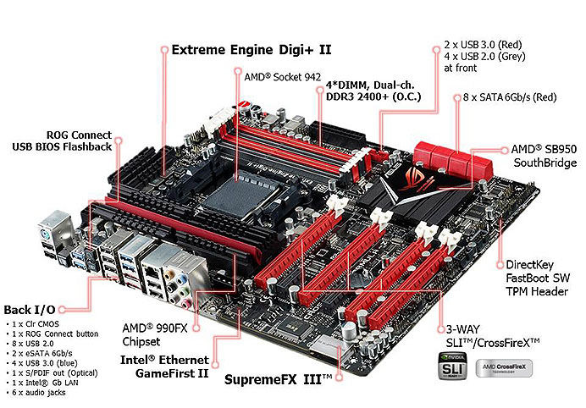
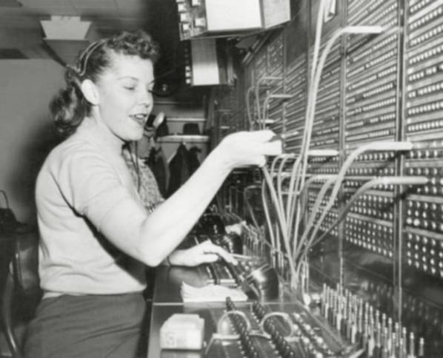
Motherboard
Notes:
What is this person doing? (Switchboard Operator)
Motherboard is kind of like a switchboard operator (operating at the speed of light), it routs all the signals to where they're supposed to go. Anytime the CPU wants to send something to the graphics card it'll just use the path provided by the motherboard.

Slide 7
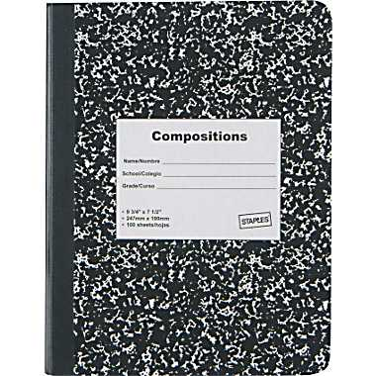
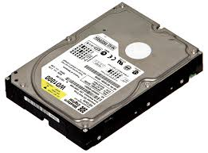
Hard Drive
Notes:
The Hard Drive is like a notebook. It stores information for a long time but is a bit slow to write to.

Slide 8
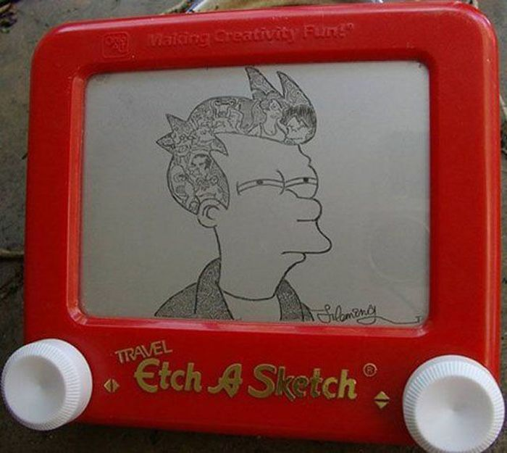
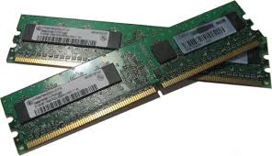
RAM
Notes:
RAM is like an etch a sketch. It stores information quickly but for a limited amount of time.

Slide 9
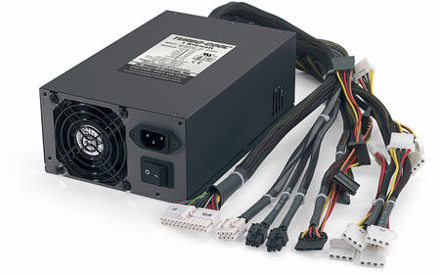
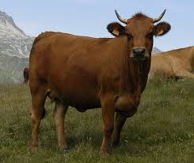
Power Supply
Notes:
The power supply is the beef. It provides and regulates all the energy the computer will need.

Slide 10
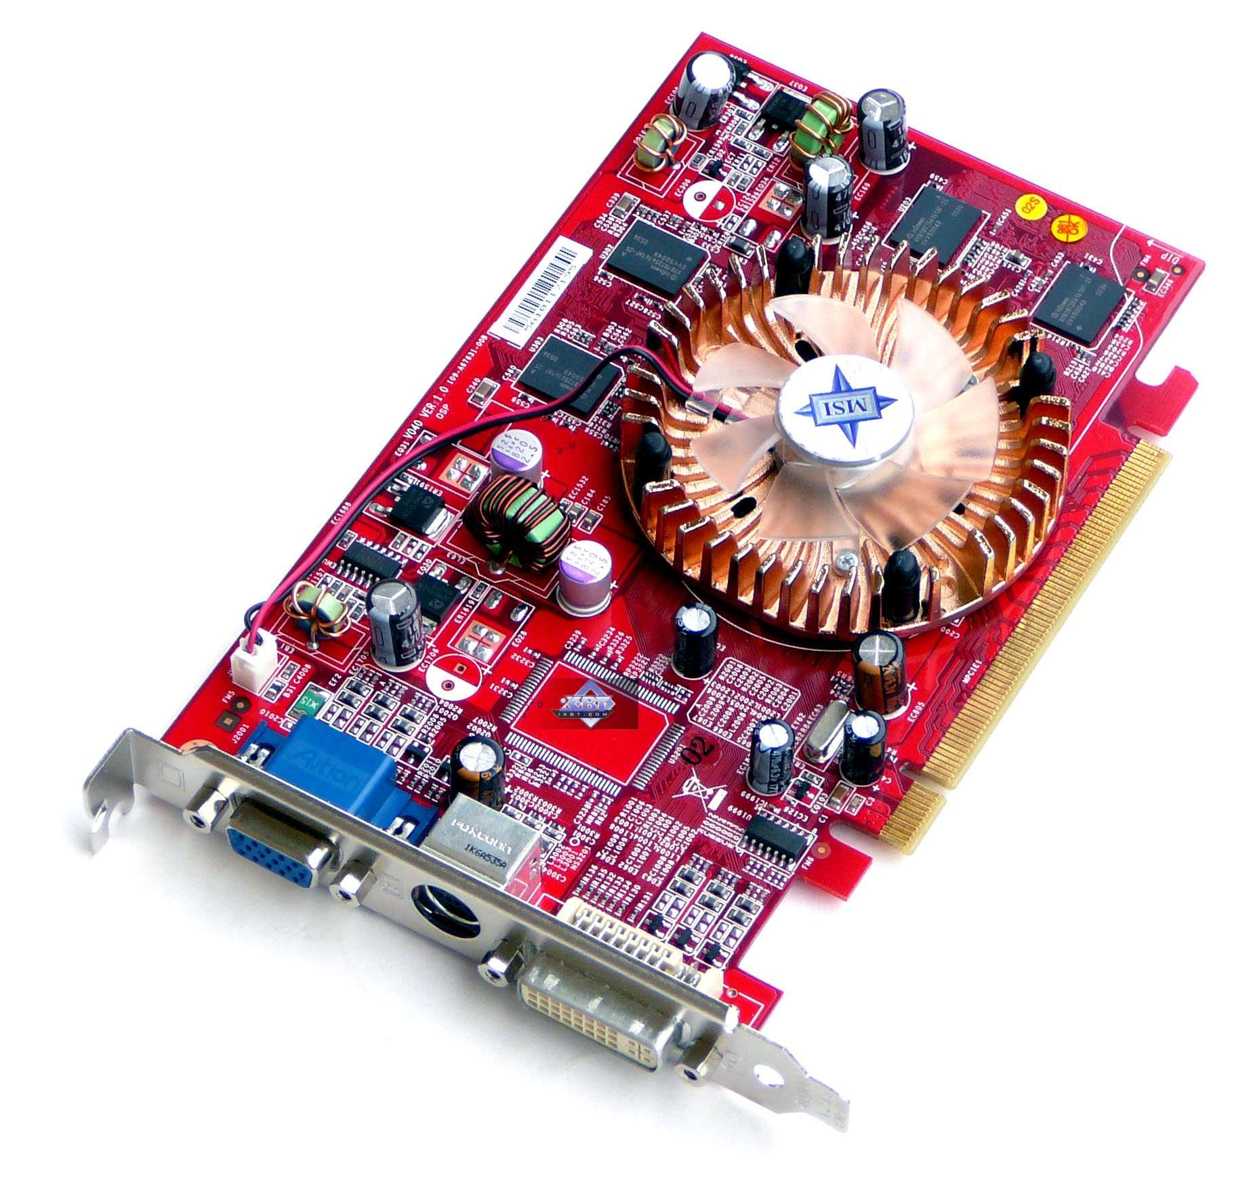
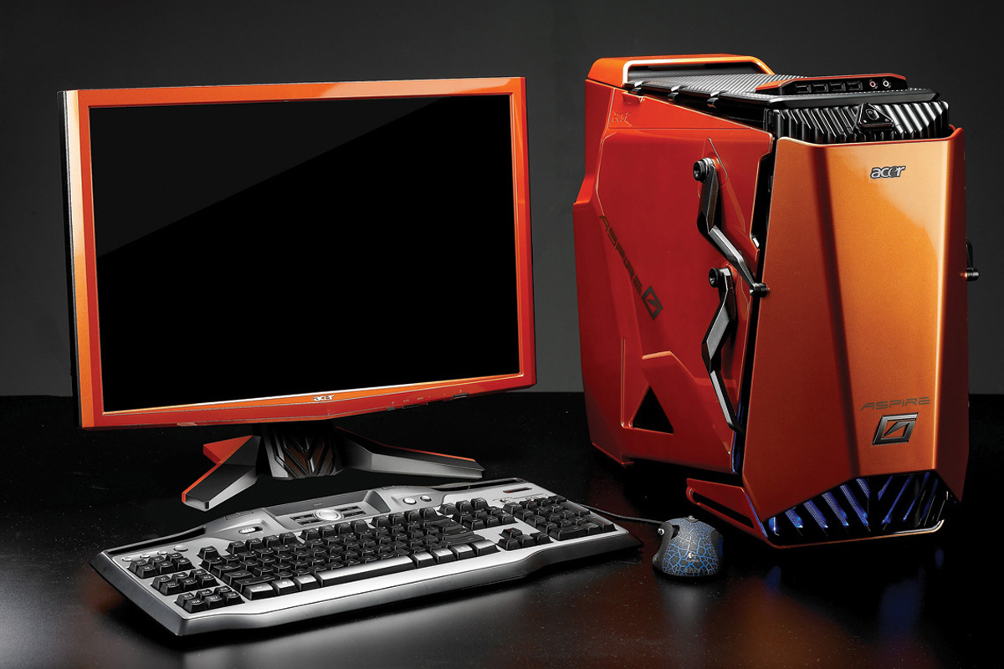
Video Card
Notes:
A video card is actually basically a specialized computer. They have their own CPU and RAM and are designed to efficiently handle tasks related to video. A regular CPU has to be good at everything, a video card has to be great at Video.
We will be using a video card which is actually embedded on our CPU and will share our RAM.

Slide 11
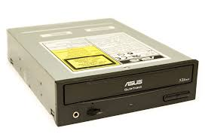
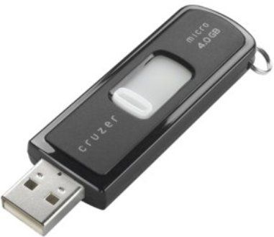
External Media
Notes:
From our picture you saw a CD-ROM drive (ancient huh?) but I just wanted to point out that we'll need some way to load our operating system on the server. We'll be using a flash drive which connects via USB.

Slide 12
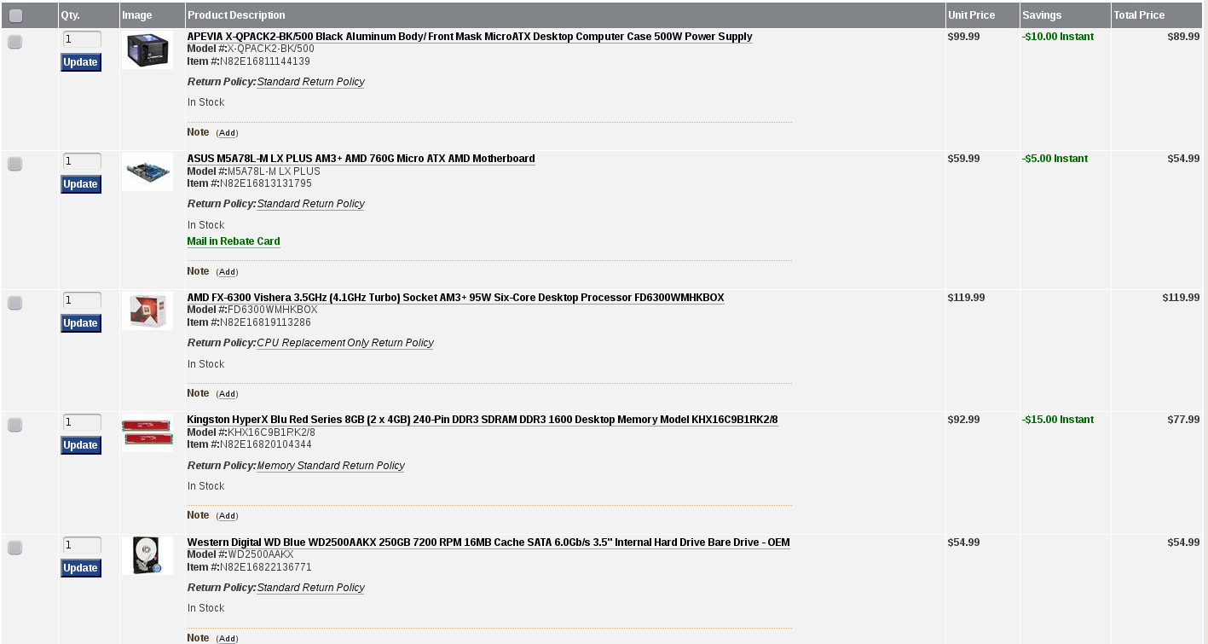

Our Parts
http://secure.newegg.com/WishList/PublicWishDetail.aspx?WishListNumber=28949867
Thanks Red Hat!
Notes:
We were able to make this because of a grant we got through Red Hat!

Slide 13
Guidelines
No magnetic screwdrivers
No static electricity
No touching the computer while the power supply is plugged in
Ask questions and listen for the beeps

